Slide 1

Data Science with Apache Spark with Big Data
Submitted by :Anamika Gupta
B.Sc Data Science ,sem -2
Submitted to:mrs.neema Jha
Assistant Professor
SODS,AAFT
SCHOOL OF DATA SCIENCE|AAFT INSTITUTE |2024

Slide 2
1
OVERVIEW
BIG DATA
HDFS ARCHITECTURE
HADOOP-1 AND HADOOP-2
MAP REDUCE
YARN ARCHITECTURE
SQOOP ARCHITECTURE
HIVE
MONGODB
SCHOOL OF DATA SCIENCE|AAFT INSTITUTE |2024

Slide 3
BIG DATA
2
Big data refers to extremely large and complex datasets that are too voluminous and intricate for traditional data-processing software. It's not just about the amount of data, but also the variety, velocity, and veracity of that data.
Volume: The sheer size of big data is enormous, often exceeding terabytes (TB), petabytes (PB), or even exabytes (EB). Imagine a library with more books than you can count, each book containing valuable information.
Variety: Big data comes in many formats, not just the neat rows and columns of spreadsheets.
SCHOOL OF DATA SCIENCE|AAFT INSTITUTE |2024

Slide 4
BIG DATA
3
Velocity: Big data is often generated and updated rapidly. Social media feeds, stock market data, or sensor readings from millions of devices create a constant stream of information. It's like a library constantly receiving new books, articles, and multimedia content.
Veracity: The accuracy and reliability of big data can be a challenge. Missing values, inconsistencies, and errors can be present. Ensuring data quality is crucial before analysis, just like verifying the information in those library resources before drawing conclusions.
SCHOOL OF DATA SCIENCE|AAFT INSTITUTE |2024

Slide 5
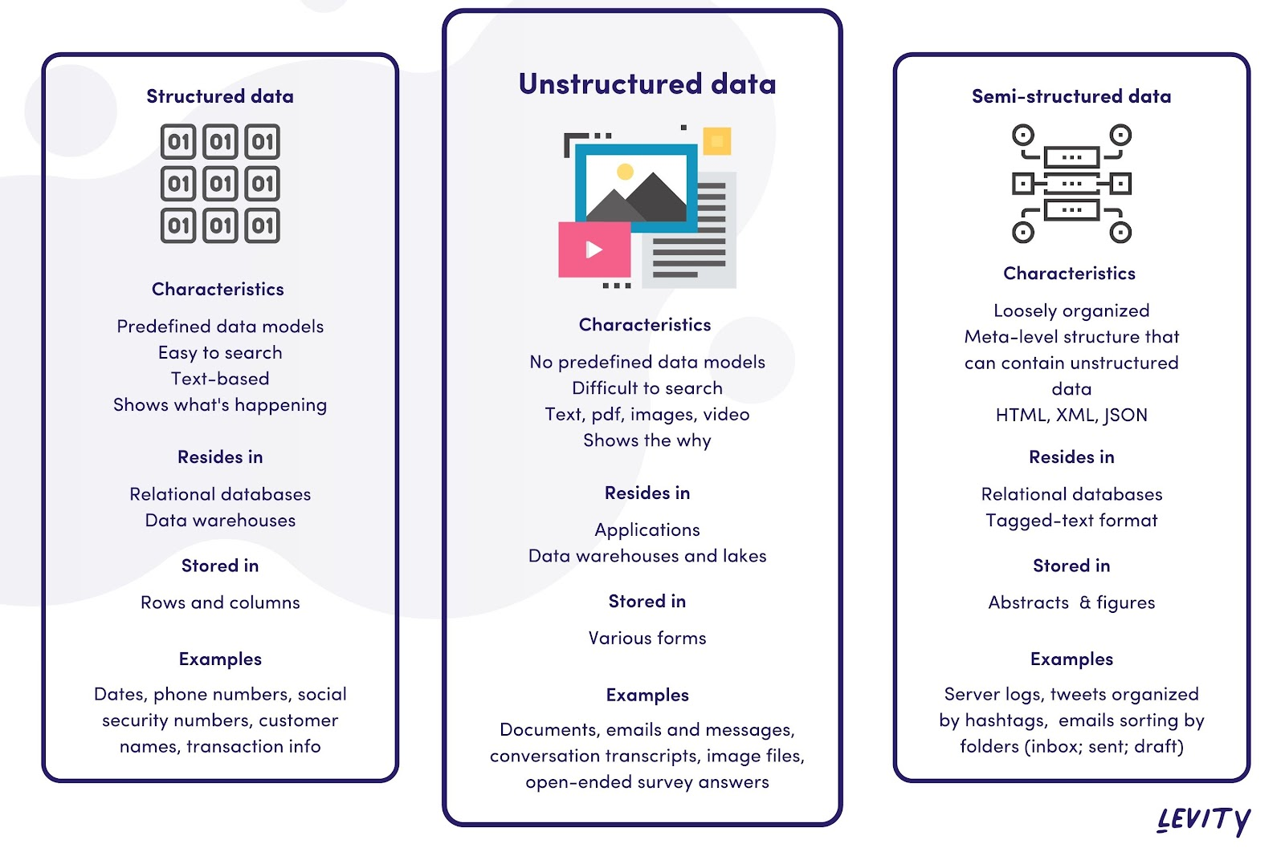
STRUCTURED AND UNSTRUCTURE & SEMI STRUCTURE BIG DATA
4
SCHOOL OF DATA SCIENCE|AAFT INSTITUTE |2024

Slide 6
Hadoop Distributed File System&Architecture:
5
HDFS (Hadoop Distributed File System) is a distributed file system designed to store large datasets across clusters of commodity hardware. Here's a breakdown of its key components and functionalities:
Architecture:
HDFS follows a master-slave architecture with the following main components:
NameNode (Master): This is the central authority that manages the file system metadata. It keeps track of the location of all data blocks across the cluster and maintains the overall namespace (directory structure) of the HDFS. Think of it as the librarian in a massive library, keeping track of the location of all books and the overall organization of the library.
DataNode (Slave): These are the machines that store the actual data blocks. Each DataNode stores a portion of a file, and multiple DataNodes store replicas of each block to ensure fault tolerance. Imagine the books themselves being distributed across various shelves in the library.
Blocks: HDFS breaks down large files into fixed-size blocks (typically 128 MB). This allows for parallel processing of data across multiple DataNodes. Think of each book chapter being a separate book in the library (for manageability).
Replication Factor: This defines how many copies of each data block are stored across different DataNodes. A replication factor of 3 means three copies of each block exist, ensuring data availability even if one DataNode fails. Imagine having three copies of each important book in different sections of the library for redundancy.
SCHOOL OF DATA SCIENCE|AAFT INSTITUTE |2024

Slide 7
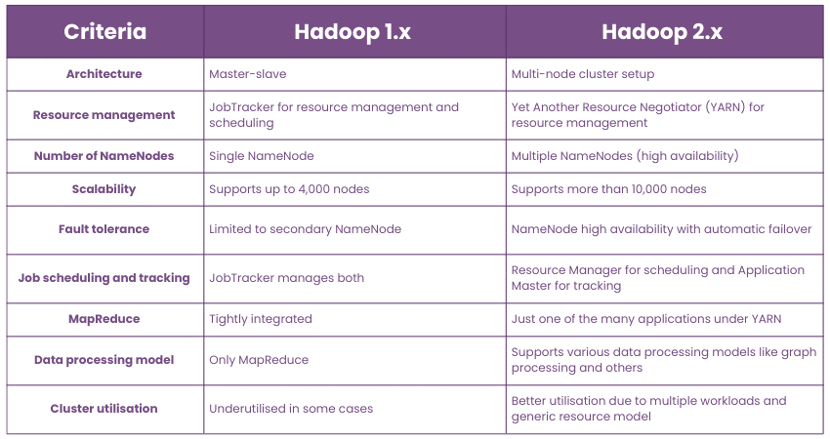
Here's a breakdown of the key differences between Hadoop 1 and Hadoop 2:
6
SCHOOL OF DATA SCIENCE|AAFT INSTITUTE |2024

Slide 8
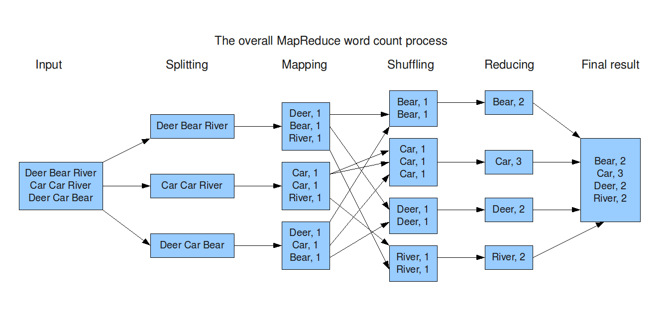
MAP REDUCE
7
Overview
It is a programming model and processing technique used for handling and generating large datasets with a distributed algorithm on a cluster.
Objective: The objective of MapReduce is to process large data sets efficiently and reliably using a parallel, distributed algorithm.
SCHOOL OF DATA SCIENCE|AAFT INSTITUTE |2024

Slide 9
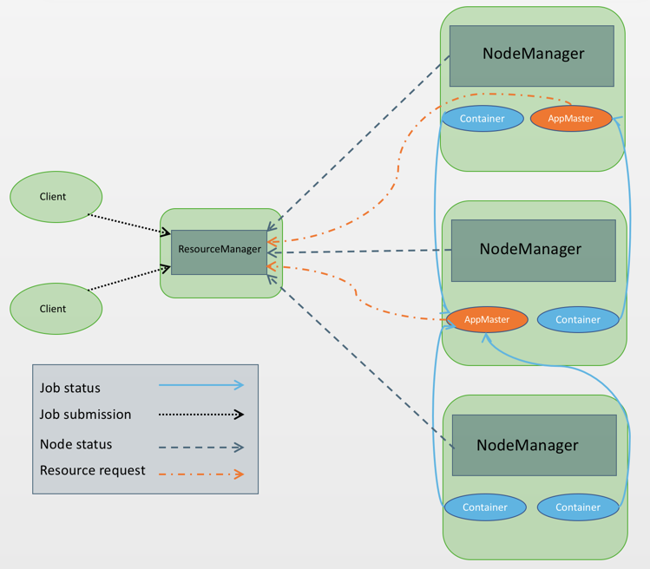
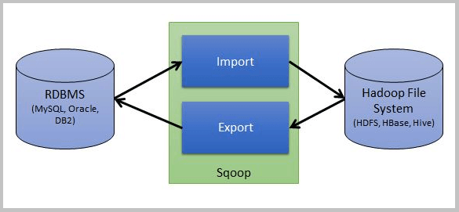
YARN ARCHITECTURE
8
YARN (Yet Another Resource Negotiator) is a core component of Hadoop 2.0 that addresses the limitations of resource management in Hadoop 1.0. It introduces a distributed and scalable architecture for managing resources in a Hadoop cluster.
SCHOOL OF DATA SCIENCE 2024
SCOOP ARCHITECTURE
Sqoop is a tool designed to transfer bulk data between relational databases and Hadoop Distributed File System .

Slide 10
SCOOP COMMANDS
9
1. sqoop import --connect jdbc:mysql://localhost:3306/retail_db --username root --password cloudera --m 1 --table customers --target-dir /user/cloudera/data_import_eg
1. sqoop export --connect jdbc:mysql://localhost:3306/retail_db --username root --password-file file:///home/cloudera/passfile --table test --staging-table test_stg --m 1 --export-dir /user/cloudera/test_null
11. sqoop import --connect jdbc:mysql://localhost:3306/retail_db --username root --password cloudera --m 2 --split-by customer_id --query 'select customer_id, customer_fname, customer_lname, customer_state,customer_city from customers where $CONDITIONS' --delete-target-dir --target-dir /user/cloudera/where_eg
SCHOOL OF DATA SCIENCE|AAFT INSTITUTE |2024

Slide 11
HIVE
10
Hive is a data warehouse software project built on top of Apache Hadoop. It provides a SQL-like interface called HiveQL (Hive Query Language) for querying data stored in various data sources like HDFS (Hadoop Distributed File System). Here's a breakdown of Hive's key features and functionalities:
HIVE PARTITIONS Partition is a way of dividing the data in a table into related parts using a partition column. Types: •Static Partition : Partitions are created whenever user specifies •Dynamic Partition : Partitions are created dynamically
SCHOOL OF DATA SCIENCE|AAFT INSTITUTE |2024
HIVE BUCKETS Hive Buckets: Bucketing in hive is the concept of breaking data down into ranges, which are known as buckets, to give extra structure to the data so it may be used for more efficient queries.

Slide 12
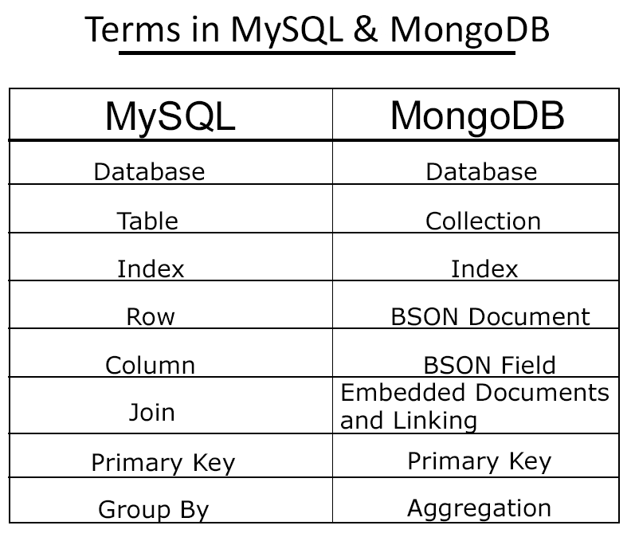
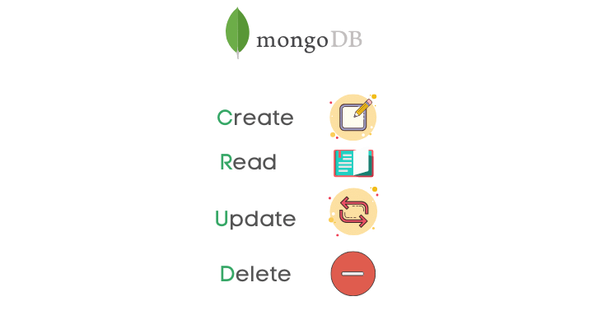
MongoDB
9
A NoSQL database based on a document model.
Stores data as collections and documents similar to JSON format.
CRUD OPERATIONS
Larana University | 2024

Slide 13
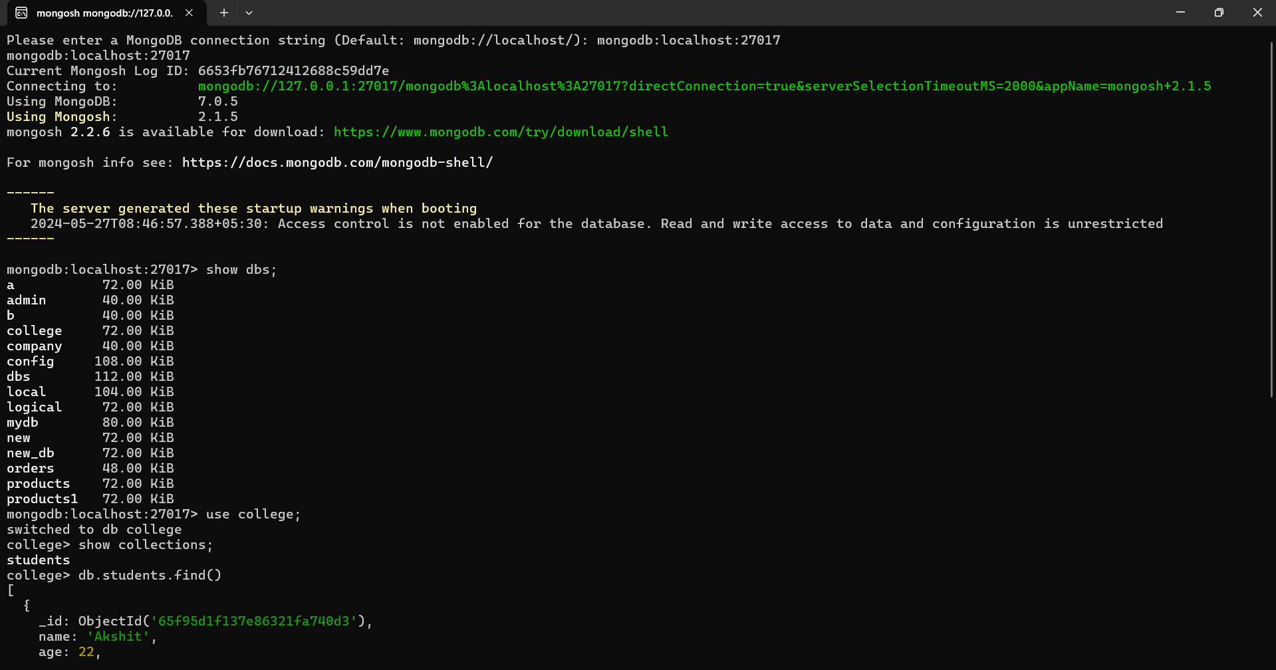
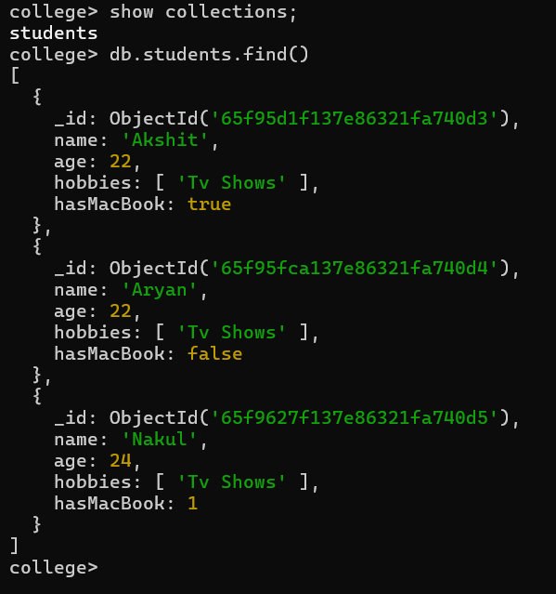
MONGODB CODES
10
Larana University | 2024

Slide 14
Thank you for your nice attention
SCHOOL OF DATA SCIENCE|AAFT INSTITUTE |2024

